Slide 1
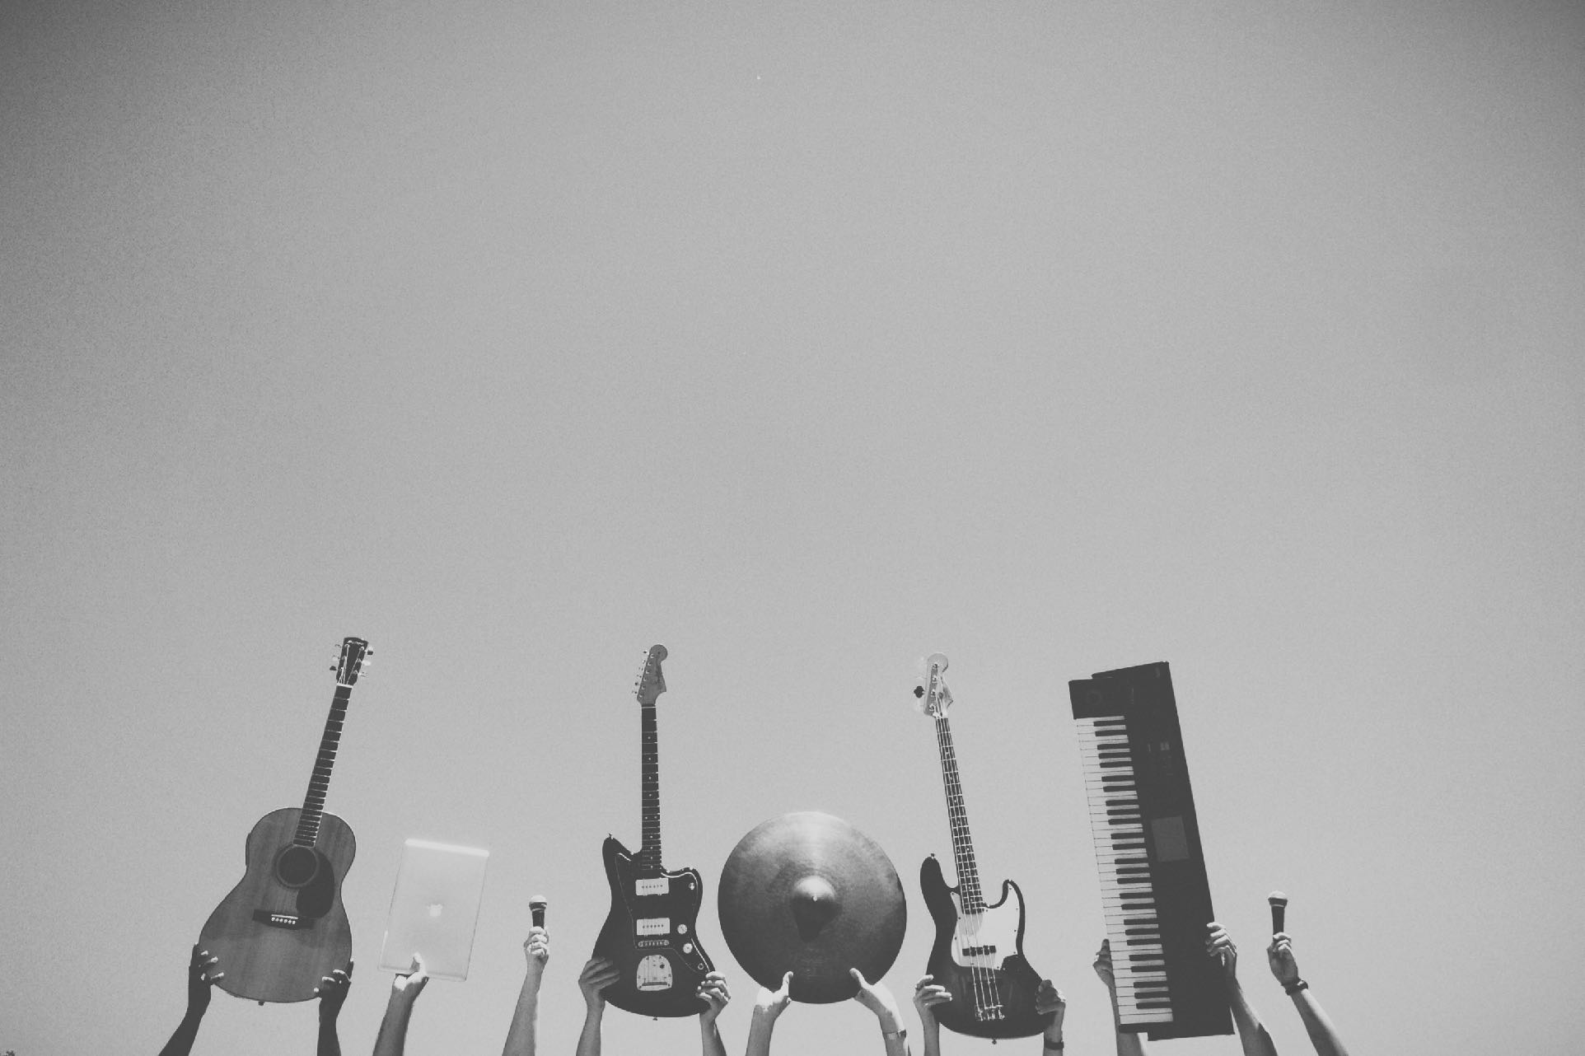
Music Magazine Pitch
Ben Macvean

Slide 2
Genre
Popular music, top 20.
For students, 16-18
Similar publications include: Billboard, Vibe and Blender

Slide 3
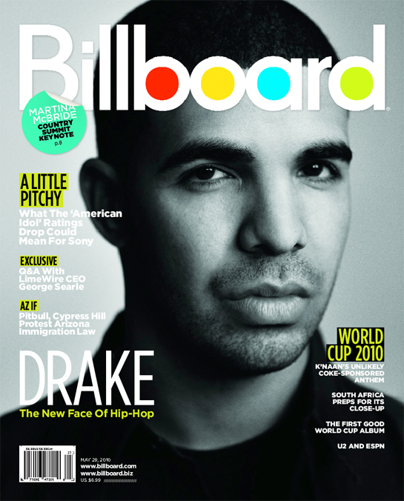
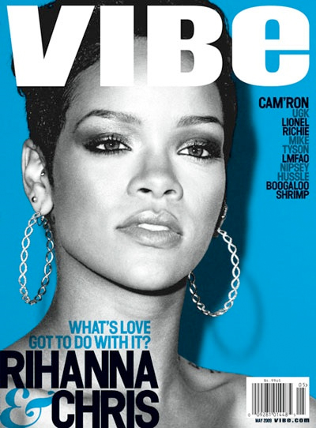
Genre

Slide 4
Notes for Examiner
Billboard. I have been influenced by the design of the headline font and simple front cover layout. I especially feel that the bright colours in the headline represent my young target audience well. I feel that the puff is a powerful way of presenting information to the audience.
Vibe. From this, I like the clean layout of the front cover. I like the bright blue background and how it goes well with the classy and sophisticated black and white picture. I especially like the three colour simple colour scheme.
Blender. The way that the cover model is in front of the headline makes the magazine look popular and stylish. Instantly recognisable. The cover model is wearing clothing which matches the colour theme of the front cover. This overall looks attractive to the target audience because of the bright colours and simple, short amounts of text neatly dotted around the page.
All three of these are American. Therefore from my research, I have concluded that there is a gap in the market in the UK for this kind of magazine.

Slide 5
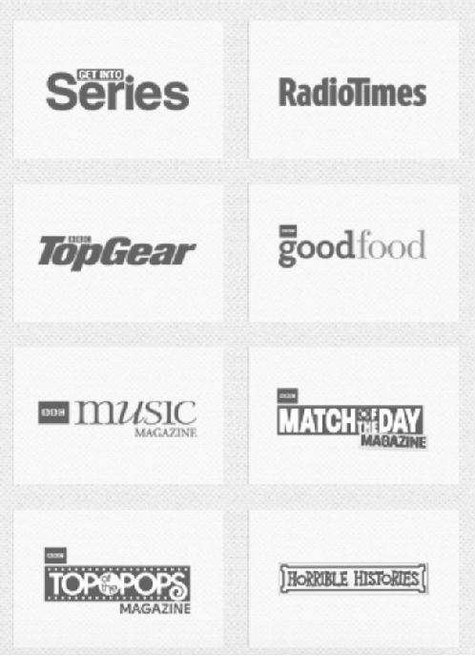
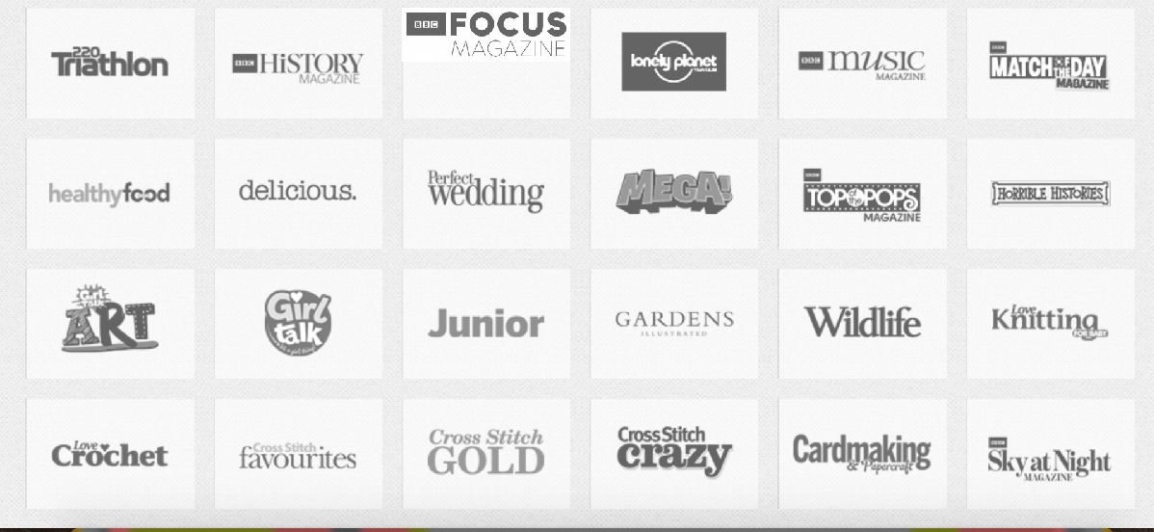
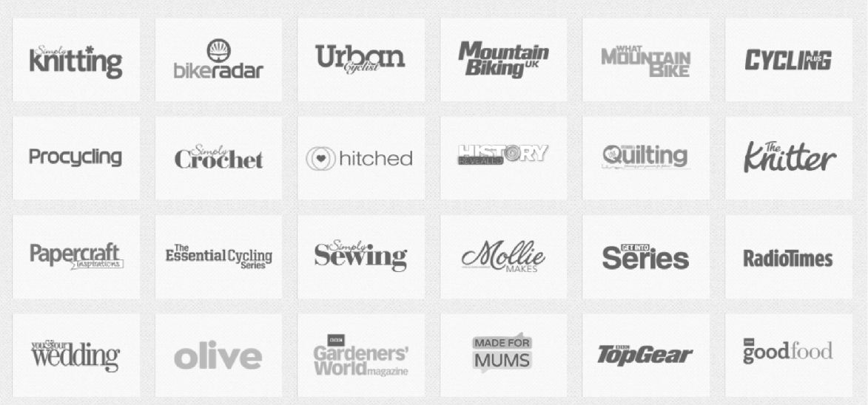
Institution
Immediate Media
Gap in the market
New audience group

Slide 6
Notes for Examiner
Through my research, looking into the brands of the top five publishers in the UK, I have come to the conclusion that Immediate Media would be the most suitable institution for my magazine.
This is because, as I mentioned in the previous notes slide, there is a gap in the market in the UK for this type of music magazine.
This publisher has not yet produced such a magazine, therefore I would be filling a gap in their market and providing a new, younger generation audience for their products.
Therefore the audience that this institution would be obtaining is students, in the E category (students with no or little income) of the ABC1 demographics chart.

Slide 7
Target Audience
Students who are around 16-18 years old.
Interested in The music that is popular at the moment.
Male and Female.

Slide 8
Notes for Examiner
The target audience for my magazine is in the E category of the ABC1 demographics chart. This means that the people who read my magazine are unemployed students with no or little source of income.
People who are in full time education. This magazine will help them relax and relieve stress from exams. This means that my magazine will be stylish and a simple, modern layout.
Physcographic: Strivers- people who find image and status as important in their lives, contented conformers- people who want to be popular, seem normal and to fit in with their piers.
Maslow’s Heirachy of Needs: Esteem needs. provides opportunities for people to fit in with their piers and be happy around people in their age group.

Slide 9
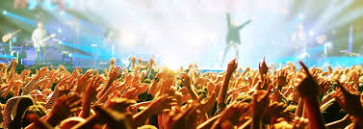
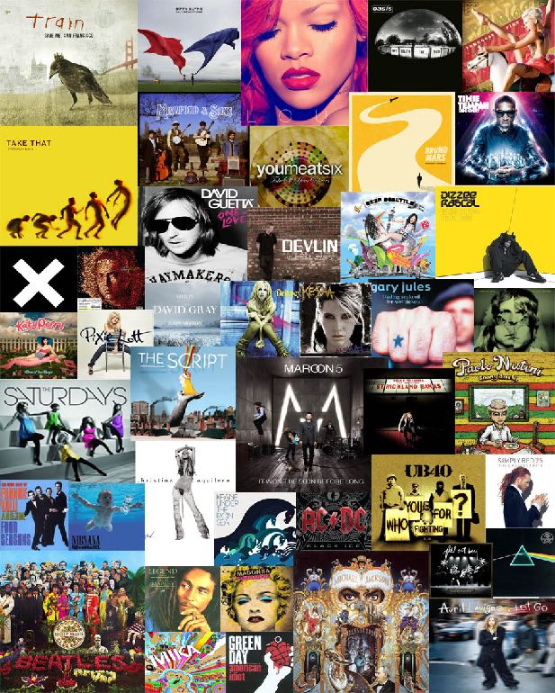
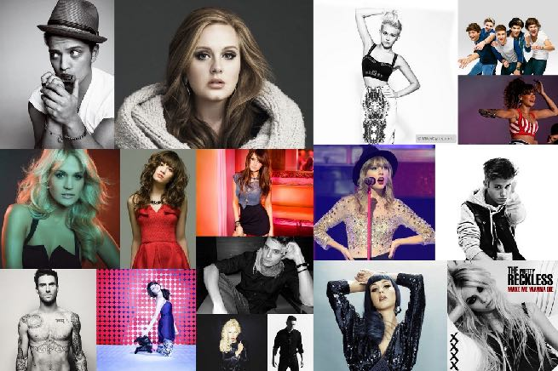
Genre

Slide 10
Notes for Examiner
The images in the mood board will all influence my magazine.
The radio stations, although perhaps slightly outdated with today’s students, I could take some design ideas, such as the colour schemes and simple shapes used in their logos.
The Union Jack Flag. I want my magazine to feature British artists, therefore my magazine will be unique compared to the US alternatives such as Vibe and Billboard.
The image on the top right further represents my ideal colour scheme and layout.
Music festivals could be a feature in the magazine. I could also include designs that are from the biggest festivals in the UK. This means that my magazine would appeal to the target audience because they are the kind of age group that go to these festivals.
The album covers and artists shown represent the style of the magazine, including the clothing and pose that my cover model/s will have, and the text to picture ratio.

Slide 11
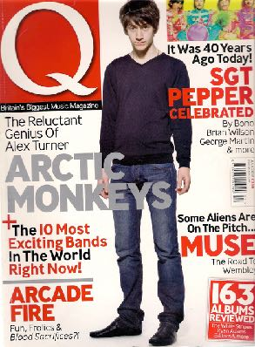
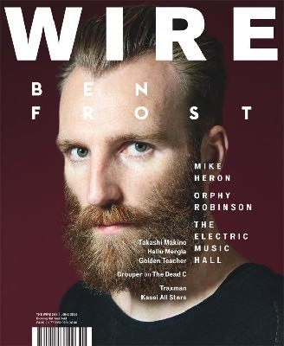
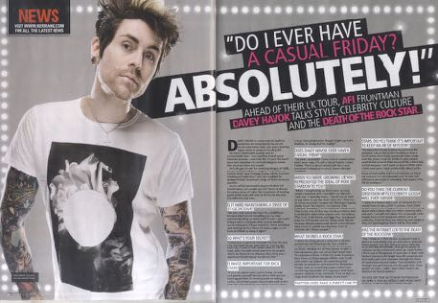
Style
Modern-looking to attract the younger generation of readers.
Colours which are associated with male and female people in the target audience.
No long sentences or big paragraphs.
Cover image covers headline- seems popular, instantly recognisable.

Slide 12
Notes for Examiner
Images of magazines:
Double page spread. This could demonstrate the design and possible colour scheme of my magazine.
Q Magazine and Wired. These are aimed at the older, more high income audience. I can take the design schemes from these magazines. They are both classy-looking and modern. I would like this to be said for my magazine.

Slide 13
Possible Names
Music Meltdown
TUNE
Top Songs
Listen Now
What Song?

Slide 14
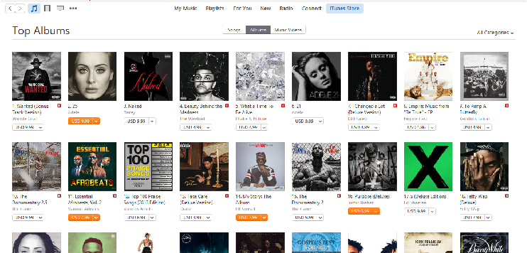
What will the magazine cover?
Articles about new songs
News about artists and their concerts
Interviews
Articles about new artists and groups
Best playlists for you
These appeal to my target audience because young people find being popular and technology important.
These articles give them an opportunity to find out what is popular in order them to fulfil their esteem needs
Top downloaded albums
VS

Slide 15
What will the double page spread cover?
An article about a new group, including how they got their song on the charts.
OR
Interview with a new solo artist, about their first experience of being on the charts.

Slide 16
Questions

