Slide 1
Music Magazine Analysis
James Gittins and Ben Macvean

Slide 2
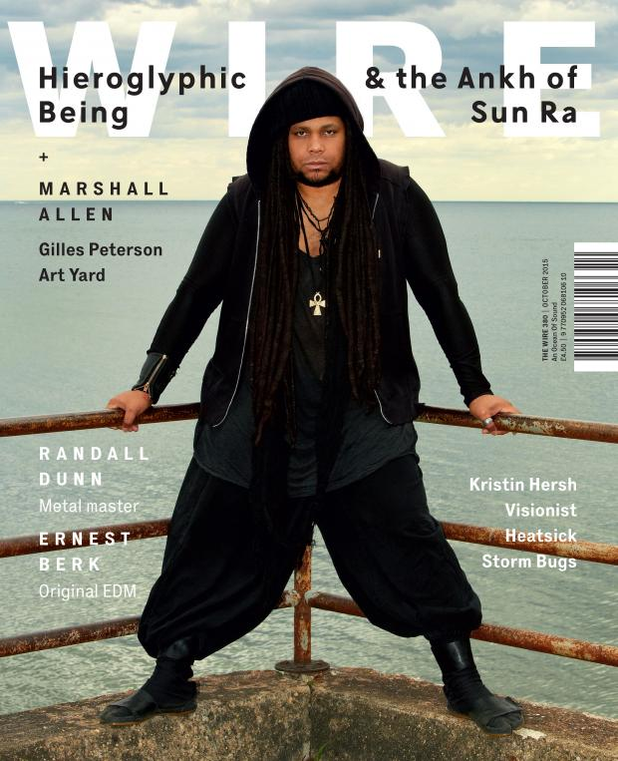
Writing Style
This magazine has simple, short sentences.
The style of writing is basic and common.
Minimalistic wording resembles the simple lives of the audience.
No mode of address.

Slide 3
Overall look
The overall impression of this magazine is simple.
The title has been put behind the person which suggests that it is a popular jazz magazine and lots of people read it.
The sublines are in front of the headline as well. This design language is copied throughout the magazine.
It does not overload you with information.
The different coloured fonts against the background make the reader look closer at the cover image to work out what the sublines say.

Slide 4
Layout
There is no tagline. This creates mystery and the reader has to look inside to find out what the magazine is about.
There is more text than pictures. This suggests that the magazine is aimed at group C and above because it is aimed at more intellectual people.
The overall layout is not jam packed with content. It is minimalistic and concise. This makes the reader want to look at it in more detail to work out what the magazine is about.
The magazine focusses on a wide variety of genres. For this reason, the magazine cover needs to be basic looking so that it draws a wide variety of people and does not just draw audiences from one genre.

Slide 5
Fonts
The font style is basic and sans serif. It is designed in this way because it is designed to appeal to lots of different types of people.
All of the fonts are bold and therefore it makes the text stand out.
Although the font is sans serif, it has capital letters and correct grammar, with no slang. This suggests that it is aimed at intellectual people.

Slide 6
Colour Scheme
Basic colours make up a simple colour scheme. Only two colours really stand out- black and white. This gives the magazine a classy look and makes it look very desirable.
The colour black shows boldness which tells us that the magazine is aimed mostly at men and people who want to make an impression.
The basic colour scheme demonstrates a wide variety of genres are written.

Slide 7
Photography
The cover model is the musician, Jamal Moss. This is a celebrity of his genre so he entices the audience who are fans of him.
His eyes are focused on the audience which allows his to stand out on the cover. It was taken live in an area that looks like it is by the sea, he is posed but the background is quite light but the foreground is dark because of the clothing he is wearing. He is stereotypical of the music genre he is representing with the dreadlocks etc.

