Slide 1
Evaluation
Click the blue underlined words to find out more…

Slide 2
Question One. In what ways does your media product use, develop or challenge forms and conventions of real media products?

Slide 3
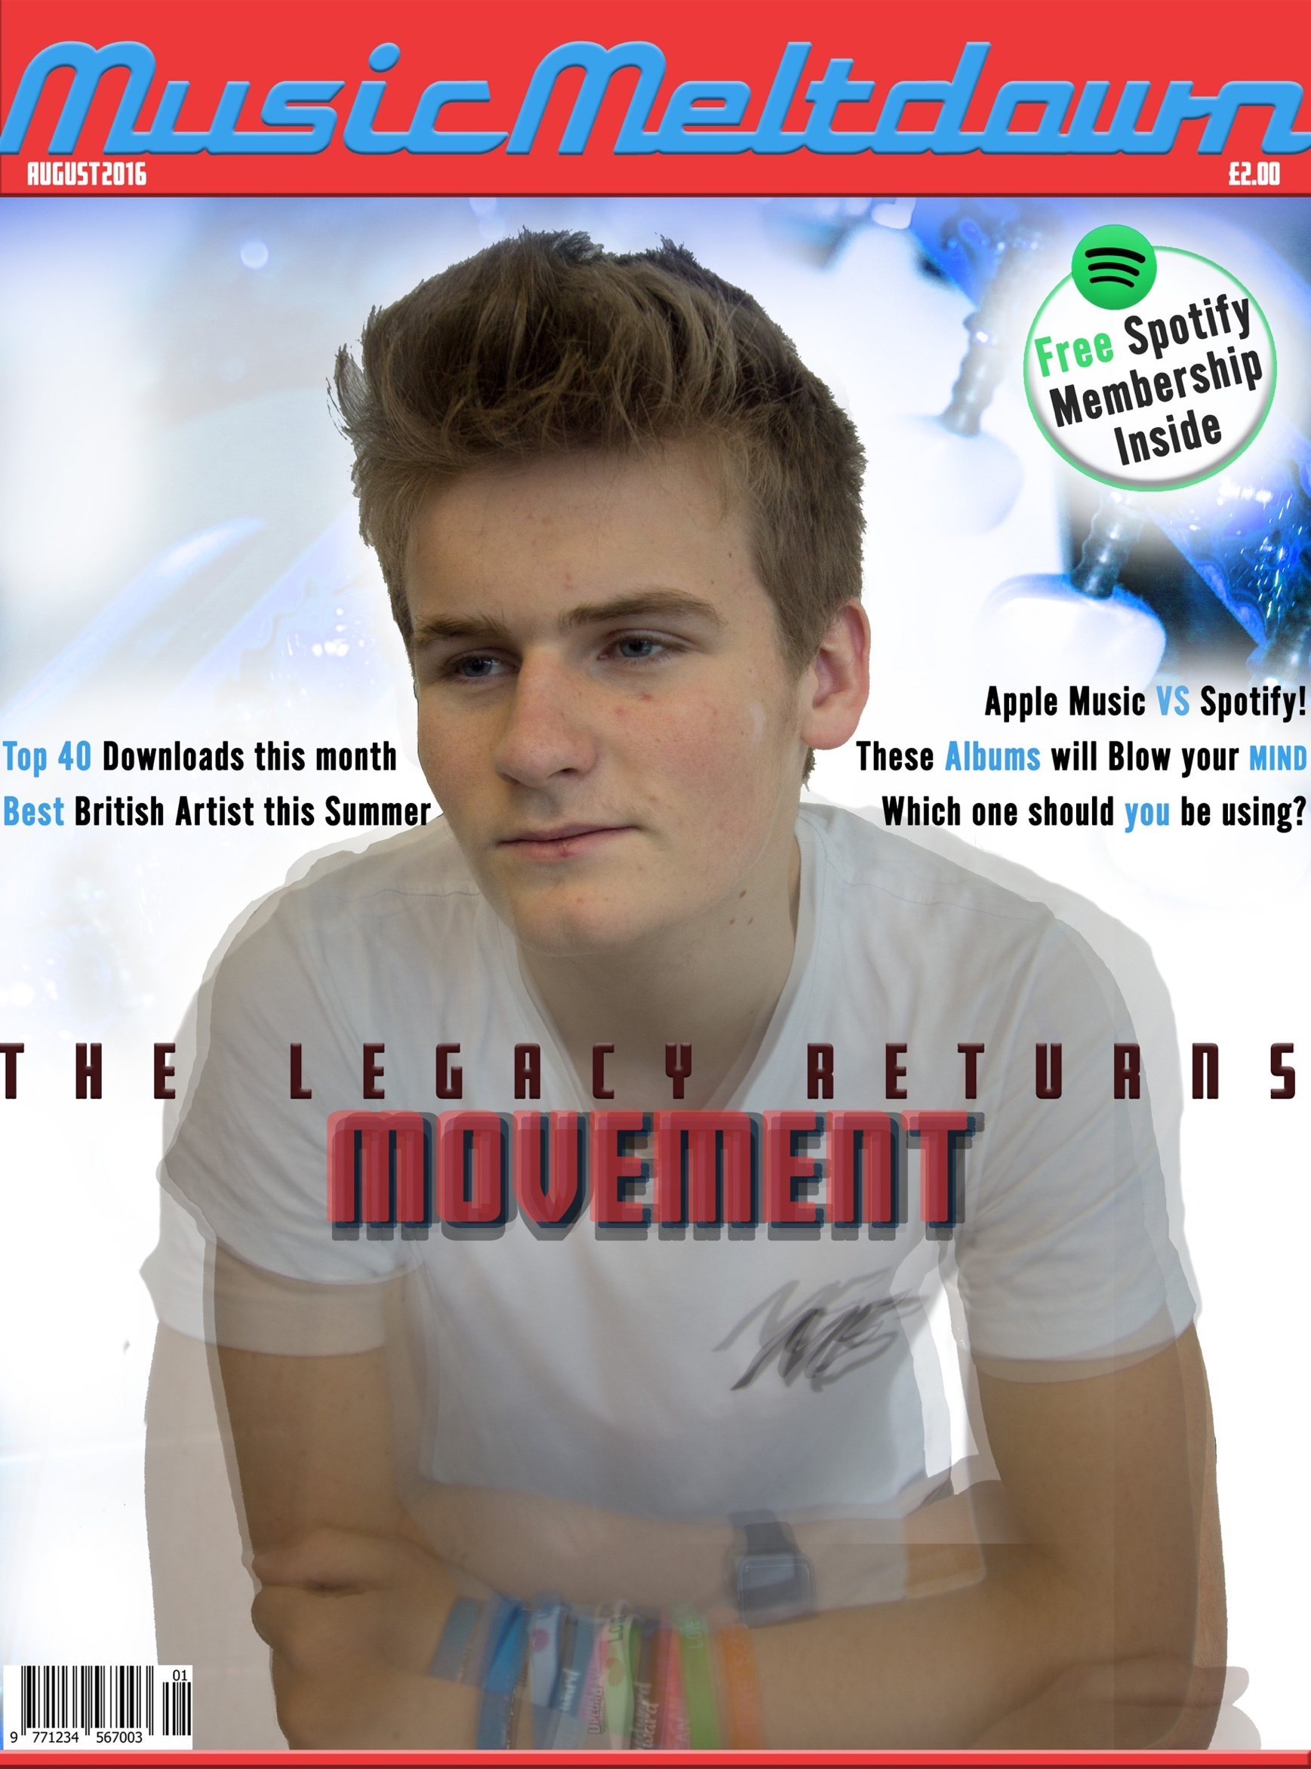
front Cover
Link to my audience profile
The sub-line is partially behind the head of the cover model. This makes the magazine seem iconic and instantly recognisable. It also helps people notice the cover model, helping to lure in the target audience. The way that I have removed part of the sub-line in order to create this look meant that there is an area of white glow could represent a halo which subconsciously relates to the cover model being a hero and a role model of his fans. For the cover image, I used 2-3 pictures from the same photoshoot and merged them into one, but for the head I erased the other images so it is clear to the audience who this person is. I used this effect because it relates to the artist’s stage name. I have used a puff which is a conventional feature of a magazine. However I have challenged convention by having no secondary images or pug. I have done this to make the magazine cover look clean and basic to draw attention to the parts which matter the most, such as the puff and main sub-line. The headline of my magazine is in the conventional place because, from my research, most magazines have the headline as the biggest feature and at the top of the front cover. This makes it noticeable and people instantly know what magazine they are buying. I believe that I have still made the audience aware of the name of my magazine in my other pages, especially the double page spread because that is where the cover story is. This, overall, is a way of luring in readers by using a celebrity figure and then giving the reader several chances to remember the name of the magazine in order to remember it in the future. This is the final version and has an improved colour spectrum and subline layout which relates to the rest of the magazine's design. The headline is now obvious and not obscured in size by 'MOVEMENT'. I have used blue images from the contents page to make sure that each page relates to each other from a design and colour perspective.

Slide 4
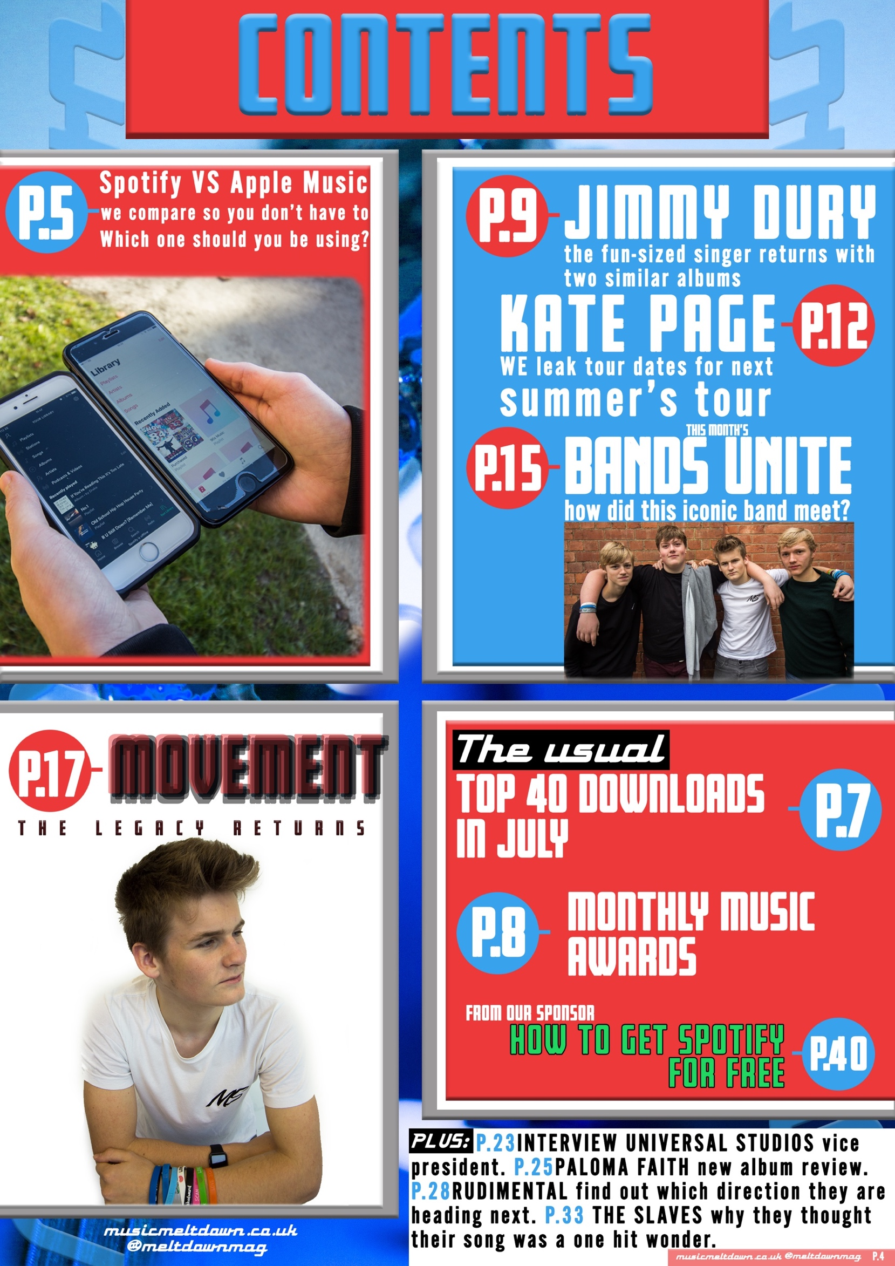
Contents Page
Link to the music magazine page on my website
The Q Magazine page
The contents page for my media product was inspired by the Q Magazine. I liked the use of circles and different sections for each story. Although this magazine is not designed for my target market, it does share some design characteristics with my initial ideas and market research. To keep the form of my design consistent throughout the magazine, I have incorporated the same three fonts and three colours on each section. The contents page features contrasting colours which stand out to the reader in order to keep them interested and to look at each section. From my market research, I aimed to use a 60:40 ratio of pictures to text. I believe that this has been successful in each section of the magazine. This is because I used large images, small text sizes and big text spacing. The final design has corrected spelling and improved content which demonstrates a contents page that has regular content each issue.

Slide 5
Double Page Spread
Link to my pitch
Link to my website
For the double page spread, I wanted to use a clean and simple design inspired by magazines such as Wired, Vibe and even Blender. I feel that the pull quote helps with drawing in readers because it is bright, big and bold. The picture that I used was taken in a studio environment and is staged. I made the background white to make it match with the images on the cover and contents pages. This makes it look clean and stylish. By having this, the page is successful in meeting my criteria listed in the pitch questionnaire conclusion. The design was improved from earlier designs by moving the pull quote to the blank shirt that the interviewee is wearing, and adjusting the paragraphs of text. Below is the final design. This helps fill out the space and make the design more relatable to the other magazine pages. From my second audience feedback questionnaire, I was able to perfect the paragraph text formatting, so that the page looks even better than earlier designs.

Slide 6
Question Two. How does your media product represent particular social groups?

Slide 7
front Cover
Link to my audience profile
I have tried to represent students who are fans of popular music genres. One way that I have done this is by including the puff which demonstrates a product of high demand, especially with this social group. The way that I have removed part of the sub-line in order to create this look meant that there is an area of white glow could represent a halo which subconsciously relates to the cover model being a hero and a role model of his fans. The colours of red blue and white resemble the British flag and therefore represents the unique British market which my magazine is predominantly for. I have represented the social group in a stereotypical way, however it is different to magazines which I have researched. These include: Billboard, Blender, Vibe and Q Magazine.
Magazine research in my pitch

Slide 8
Contents Page
Link to the contents page that inspired mine
The contents page for my media product was inspired by the Q Magazine. I liked the use of circles and different sections for each story. Although this magazine is not designed for my target market, it does share some design characteristics with my initial ideas and market research. From my market research, I aimed to use a 60:40 ratio of pictures to text. This would be the best balance for my social group.

Slide 9
Double Page Spread
Link to the audience profile
The quote attracts the audience because it is bright and relates to the male half of my social group as blue is considered to be a masculine colour. I have therefore used a conventional method to represent my social group on the double page spread. I have kept this page simple. This is because I concluded from the questionnaire given to members of the target market that this would be the best way to present the magazine. The Image shares this simple layout, the white shirt on the white background was the most simple way to present my artist.

Slide 10
Question Three. What kind of media institution might distribute your media product and why?

Slide 11
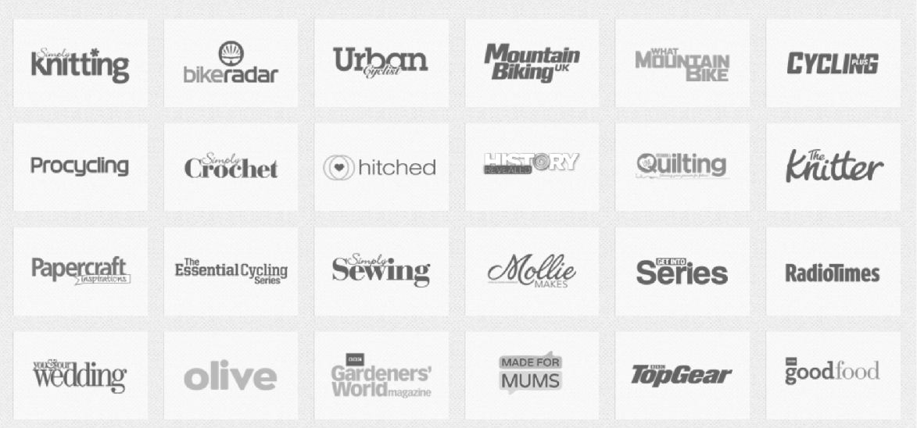
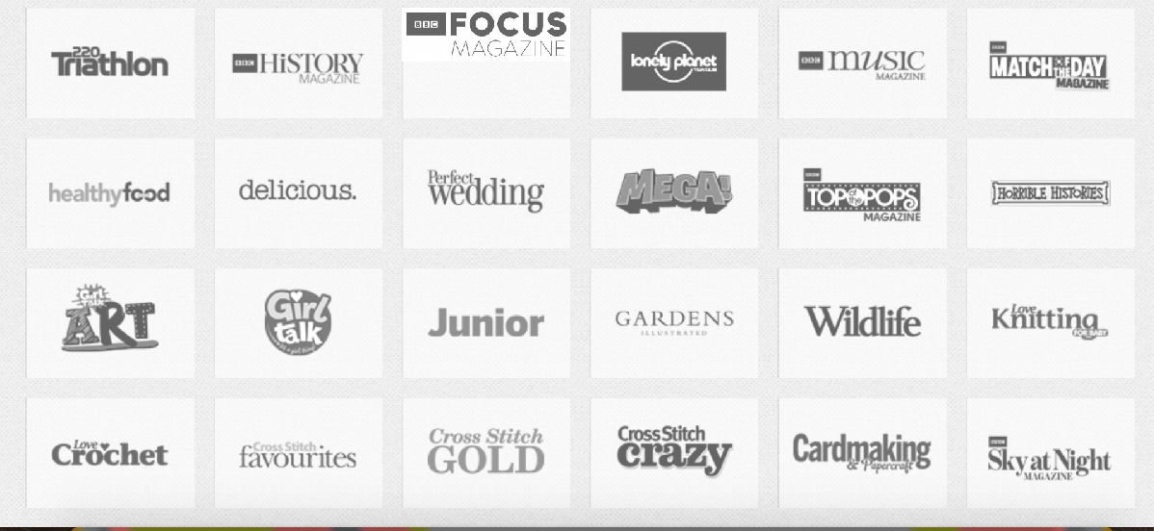
Media Institution
Immediate Media
Gap in the market
New audience group
Link to my pitch
How I chose immediate media
In my pitch, I chose Immediate Media as my publisher. This is because it would bring a new market to them. Nothing like my magazine is available at the moment in the UK. I wanted to change that with my magazine. Through my research, looking into the brands of the top five publishers in the UK, I came to the conclusion that Immediate Media would be the most suitable institution for my magazine. This is because of the gap in the market in the UK for this type of music magazine. This publisher has not yet produced such a magazine, therefore I would be filling a gap in their market and providing a new, younger generation audience for their products. Therefore the audience that this institution would be obtaining is students, in the E category (students with no or little income) of the ABC1 demographics chart.
Immediate media’s website

Slide 12
Question Four. Who would be the audience for your media product?

Slide 13
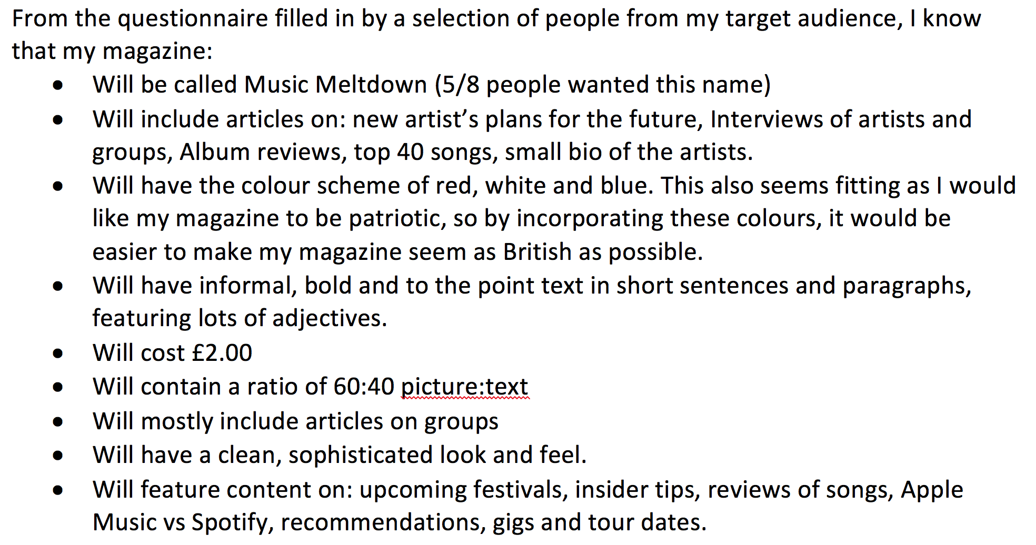
Audience
My magazine is successful in gaining the interest of my chosen target audience. This is because when I was creating it, I kept looking back at the conclusions that I made based on the direct opinions of members of the target market.
From my pitch, my audience was British students around 16 to 18 years old. Male and female and interested in popular music genres. The kind of music they would listen to is chart toppers, as shown in the link on the left. This means that the kind of content that they would read should be gossip style, factual information about artists. I feel that my magazine caters for this need successfully.
The target audience for my magazine is in the E category of the ABC1 demographics chart. This means that the people who read my magazine are unemployed students with no or little source of income. People who are in full time education. This magazine will help them relax and relieve stress from exams. This means that my magazine will be stylish and a simple, modern layout.
Physcographic: Strivers- people who find image and status as important in their lives, contented conformers- people who want to be popular, seem normal and to fit in with their piers.
Maslow’s Heirachy of Needs: Esteem needs. provides opportunities for people to fit in with their piers and be happy around people in their age group.
Click this to hear the kind of music my audience listens to
What kind of music does my audience listen to?
Students who are around 16-18 years old.
Interested in the music that is popular at the moment.
Male and Female.

Slide 14
Question Five. How did you attract/address your audience?

Slide 15
Attracting the audience
Link to my website
Use off a puff to give people more reason to buy it!
From my research, I know that the front cover is the most important way to attract an audience. Statistics state that 70% of people buy magazines on the spur of the moment. I have included a puff which contains information that relates to the target audience and makes them interested because they recognise the brand. By including the Spotify logo, I have brought a familiar part of my audience’s lives onto my magazine. This would lead to the audience wanting to buy the magazine, as it would seem more welcoming than other magazines on the market. I have set the price at what is considered to be low in the magazine industry (£2). I did this to attract my audience of students because I know that most students do not have a full time job. From my research, I noticed that magazines in my market have prices that begin at £4. My strategy with this magazine is to include more adverts than competition in order for the institution to maintain an acceptable profit. The sub-line is partially behind the head of the cover model. This makes the magazine seem iconic and instantly recognisable. It also helps people notice the cover model, helping to lure in the target audience. The way that I have removed part of the sub-line in order to create this look meant that there is an area of white glow could represent a halo which subconsciously relates to the cover model being a hero and a role model of his fans. I decided to make the headline smaller on my magazine because it was not the main focus. I wanted to draw attention to the cover model and the first sub-line because it would interest the target market more than the headline. I believe that I have still made the audience aware of the name of my magazine in my other pages, especially the double page spread because that is where the cover story is. This, overall, is a way of luring in readers by using a celebrity figure and then giving the reader several chances to remember the name of the magazine in order to remember it in the future.
Audience profile

Slide 16
Contents Page
The contents page features contrasting colours which stand out to the reader in order to keep them interested and to look at each section. From my market research, I aimed to use a 60:40 ratio of pictures to text. I believe that this has been successful in each section of the magazine. This is because I used large images, small text sizes and big text spacing.

Slide 17
Double Page Spread
Link to my audience profile
The quote attracts the audience because it is bright and relates to the male half of my social group as blue is considered to be a masculine colour. I have therefore used a conventional method to represent my social group on the double page spread. I have kept this page simple. This is because I concluded from the questionnaire given to members of the target market that this would be the best way to present the magazine. The image shares this simple layout, the white shirt on the white background was the most simple way to present my artist. People do not get distracted and are subtly forced to look at the bright quote and the face of the artist. By doing this, the audience is likely to become aware of who the artist is the quicker they see their face. This would lead to more attraction to my magazine.
Link to the website

Slide 18
Question Six. What have you learnt about technologies from the process of constructing this product?

Slide 19
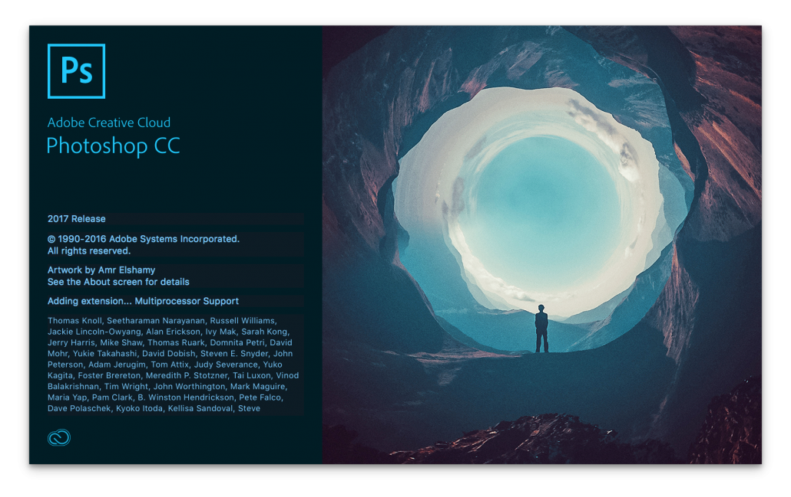
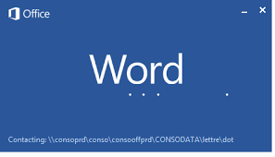
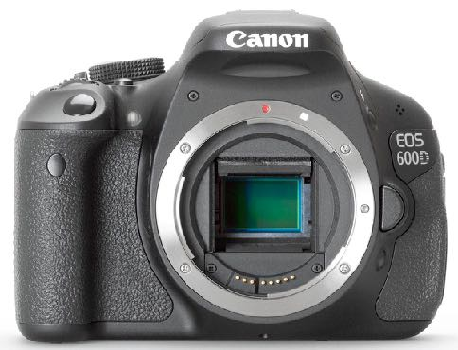
Technology
Throughout the entire process, I used Adobe Photoshop to design the media product and Microsoft Word to create two paragraphs for the double page spread. I am comfortable using both pieces of software and I was able to use skills that I had learnt in the preliminary task, such as the gaussian blur effect and stroke. The main benefit of Photoshop for me is that it is very simple and diverse. Meaning that it does not take long to create any design that comes into your head. Word is a very simple to use too, however you can not get the same professional quality results that you can achieve with Photoshop. I wrote in Word because of its autocorrect functionality. Unfortunately Photoshop does not have this feature. The main piece of hardware that I used was my Canon 600D. I am relatively inexperienced with DSLRs however I believe that I have managed to create some good work from the photoshoot. Technology has helped me gather my research. I used Keynote (Apple’s version of PowerPoint) to create my pitch and I was able to use Word to create a questionnaire and use the table feature to collect and sort the information. This made it easy to know what to include in my magazine. The way that I organised and displayed my work was by uploading to a free website builder called ‘Weebly’. This is much easier than what I would have had to do before the internet and web 2.0, cross media convergence has made it much easier to display work, rather than posting a big folder, with the risk of damaging or losing work.
What’s the difference?

Slide 20
Question Seven. Looking back at your preliminary task, what do you feel you have learnt in the progression from it to the full product?

Slide 21
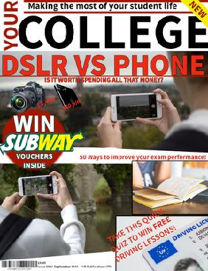
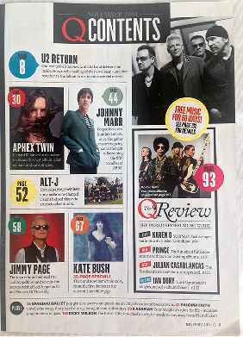
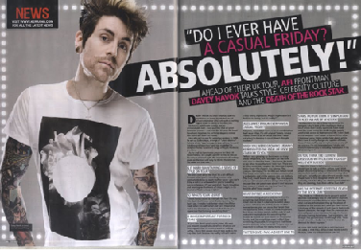
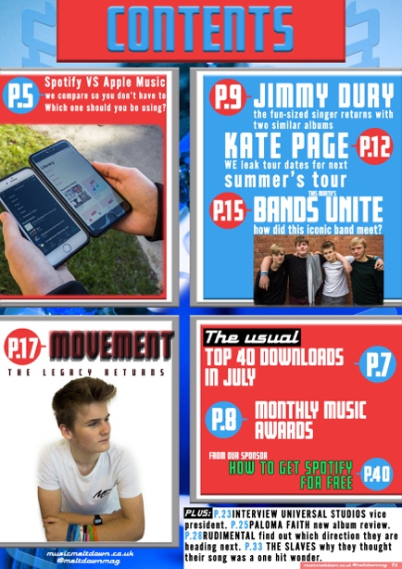
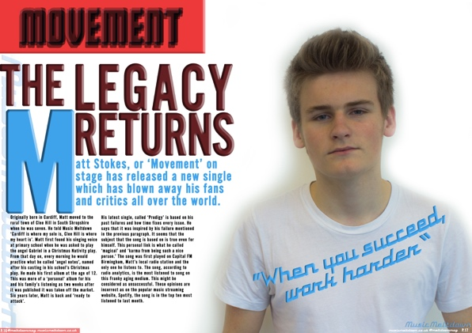
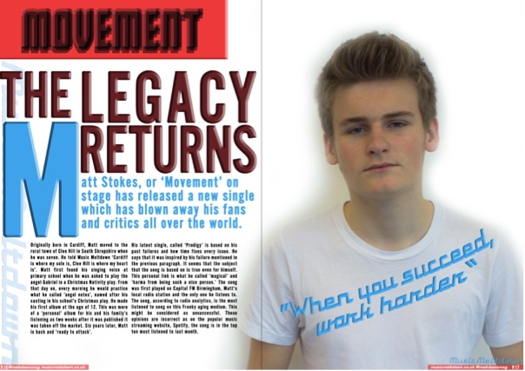
What I Have Learnt
From the preliminary task, I feel that I have improved my Photoshop skills. This has made my work much more professional looking. I have learnt about how to blend layers, use filters and use effects. I now understand that, in order to make something look professional, you can not always just put in text. With the front cover for the music magazine, I made the main sub-line using the opacity adjustment, colour picker, nudge and duplicating layers. With the front cover for the college magazine, all I did was put a stroke around the main sub-line text. By learning more sophisticated techniques, I was able to produce a more sophisticated looking final product.
Since the preliminary task, and due to my research, I have developed a deeper understanding about how magazines are made and why they are made. The design and content choices that the publishers make are to attract a target audience into buying the product. With my final task, I was constantly reminded of this by looking at magazines that are on the market and similar to my final magazine in one way or another. With all of these influences, I was able to create a successful magazine front cover, contents page and double page spread. Successful in that it contains features which attract the target audience. The way that these features are displayed is something that I have improved upon from my preliminary task. For example, the two sub-lines and images in the bottom right are basic and not pleasing to look at. They do not impress the audience or stand out from the other magazines currently on the market. From this, I wanted my final magazine to use a sophisticated, tried and tested design language which is shared by popular magazines such as Q and Wired. This would help to attract the audience because the designs look of high quality. The first impression is very important. That is why I wanted to improve on my designing skills in order to obtain the largest audience possible.

