Slide 1
Music Magazine Analysis
Ben Macvean

Slide 2
Writing Style
The writing style of this magazine is basic and informal. There is some direct language in the purple puff. This engages the reader and makes them feel like the magazine is personal and meant to be for them individually.
The language is informal but reminiscent of the blues and soul genre's cultural roots in Mid-America. An example of this is language such as 'fancy a drink'. It gives the reader a taste of the culture that the genre was born out of.
The language register is kept relatively informal. This is mostly done to achieve a native tone which the audience can relate to.

Slide 3
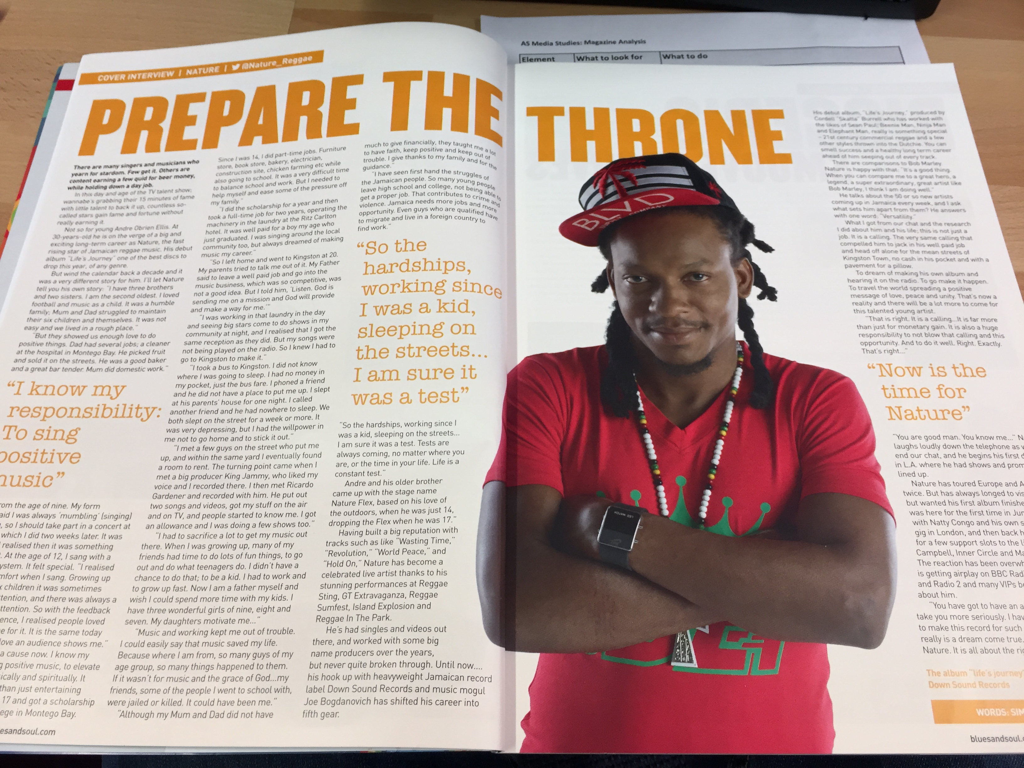
Overall Look
The overall impression is that the design is busy and the features use up the available space on the front cover quite well. The interior pages are full of mostly text but with large quotes and big pictures that break up the text. This suggests that the magazine is aimed at people in the C1 to D demographic.

Slide 4
Layout
The text to picture ratio is quite even. There is a lot of text and few large images. This suggests that the target audience is relatively mature or hardcore fans of this genre. The layout of this magazine is busy. This is because each feature takes up a lot of space in order to get the message across to the reader. This reflects the genre because the big features remind us of the big and heavy bass in blues and soul music.

Slide 5
Fonts
All fonts on the front cover are in capitals apart from one word. 'Revealing' is in normal font size because the look they are trying to achieve would not work. The look for this word is a classy retro font which definitely appeals to the target audience because it has direct inks with classic blues and soul events, posters etc. This retro look is popular with the fans of this genre and for that reason this is an effective font to use. The fonts are big especially 'NATURE'. It is bigger than the headline. This tells me that the designer has gone with a whacky look which denies the conventions that one would expect with a regular magazine front cover. The rest of the fonts are bold and big. This helps to engage with the audience as the sublines etc. are more noticeable.

Slide 6
Colour Scheme
The colour scheme on the front cover is mostly basic however there are some breaks to the red, black and yellow rule that is evident in the design. The puff is purple. On this occasion I believe that this break is acceptable because the colour is popularly associated with the contents of this feature. This makes the puff look more relatable with its contents and looks more understandable. It stands out from the rest of the front cover because of its colour. This could help bait the audience. Another break to this convention is the orange square with the blue, bold text. This, again links to the contents of this feature and it makes it stand out.

Slide 7
Photography
The photo is of a musician who features in the magazine. This means that his own fans might want to buy the magazine just because of him. The photo has been staged and had been taken in a controlled, studio environment. You can tell this because the background is even and well lit. The focus is all on the subject. The cover model is posing, this tells us that the photo is staged and thought through. This is done in order to represent his character in an exaggerated way. This ensures that people are aware of him and therefore spot the magazine in the shop to buy it. The fact that the hat is positioned slanted on his head resembles the genre he is from and this appeals to the target audience because it relates to the clothing style that the readers would stereotypically wear. The fact that he is wearing red matched the headline. This makes the magazine look more aesthetically pleasing. He is also wearing sunglasses. This suggests that he is hiding behind them which makes him seem mysterious and makes the audience. He is holding the sunglasses as well. This suggests that he is insecure about featuring on the front cover. Perhaps he is famously known as hiding his identity from the media. This makes him seem trendy and attractive to the target audience because they appreciate his actions.

